Slide 1
COMP 4320
Intro. to Computer Networks
C/C++ Socket Programming
Alvin Lim
Computer Science and Software Engineering
Auburn University

Slide 2
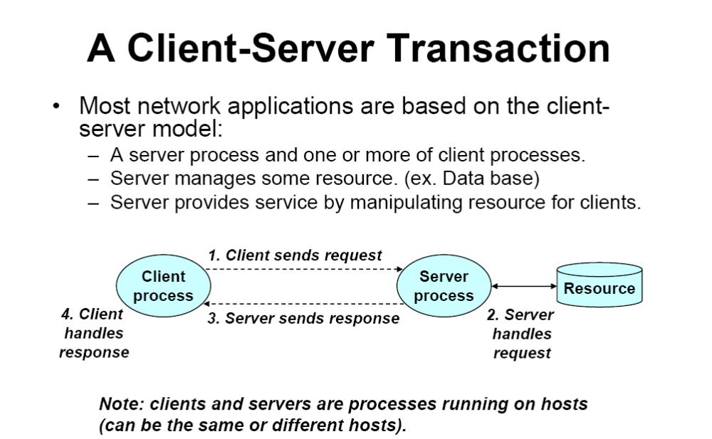

Slide 3
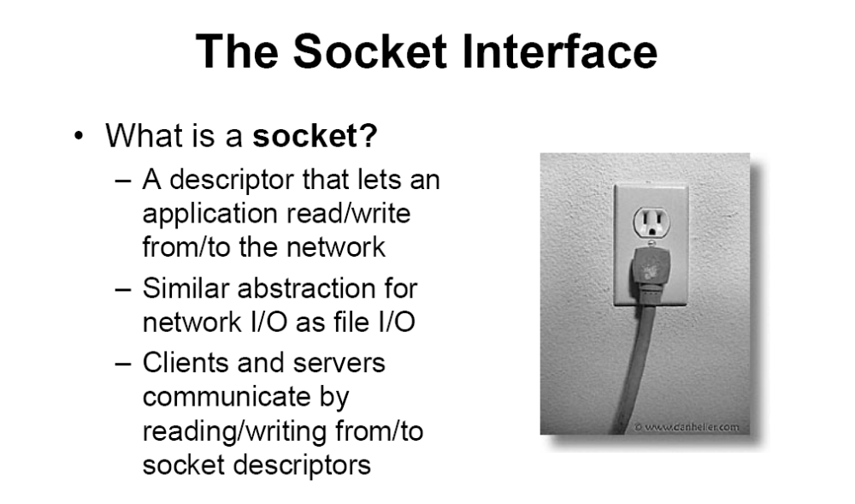

Slide 4
Socket API
Socket API originated with the 4.2 BSD system released in 1983
Sockets – A way to speak to other programs using UNIX file descriptors.
A file descriptor is an integer associated with an open file. This can be a network connection
Many types of Sockets – DARPA Internet addresses (Internet Sockets), Unix Sockets, X.25 Sockets, etc
Types of Internet sockets
  SOCK_STREAM uses TCP (Transmission Control Protocol) Connection oriented and Reliable
  SOCK_DGRAM uses UDP (User Datagram Protocol)
  Connectionless and Unreliable

Slide 5
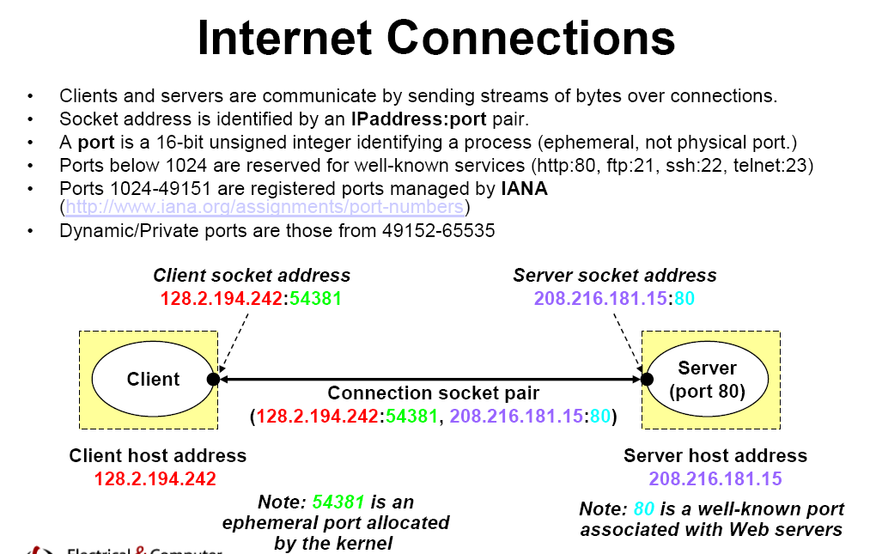

Slide 6
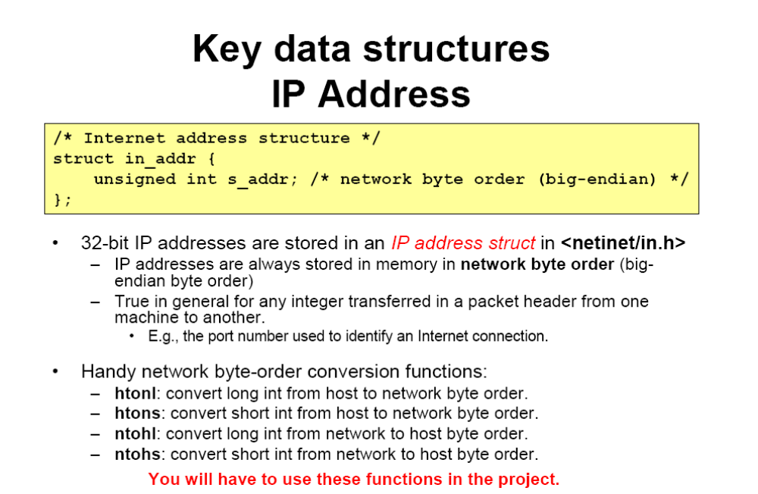

Slide 7
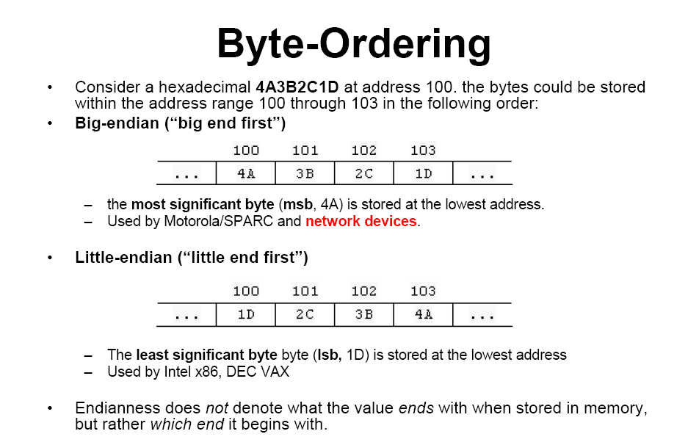

Slide 8
IP Address Conversion Routines
tux178.eng.auburn.edu 131.204.14.178
leaky.eng.auburn.edu 131.204.12.6
Other COE machines for use tux175 – tux198, roadrunner
#include <sys/socket.h>
# include <netinet/in.h>
# include <arpa/inet.h>
inet_addr() converts an IP address in numbers-and-dots notation into unsigned long
unsigned long inet_addr(char *ptr);
e.g.
ina.sin_addr.s_addr = inet_addr(“129.110.43.11”) // Network byte order
inet_aton() also converts ascii to network address
int inet_aton(const char *cp, struct in_addr *inp);
inet_ntoa() returns a string from a struct of type in_addr
char *inet_ntoa(struct in_addr inaddr) ;

Slide 9
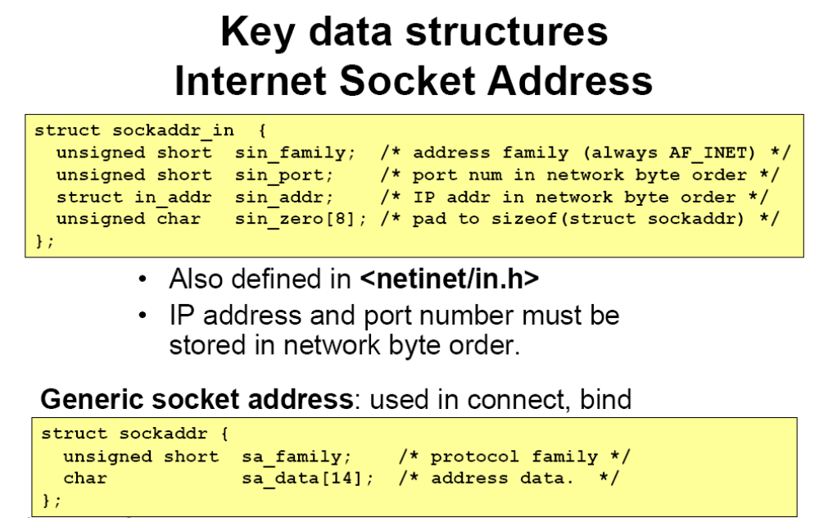

Slide 10
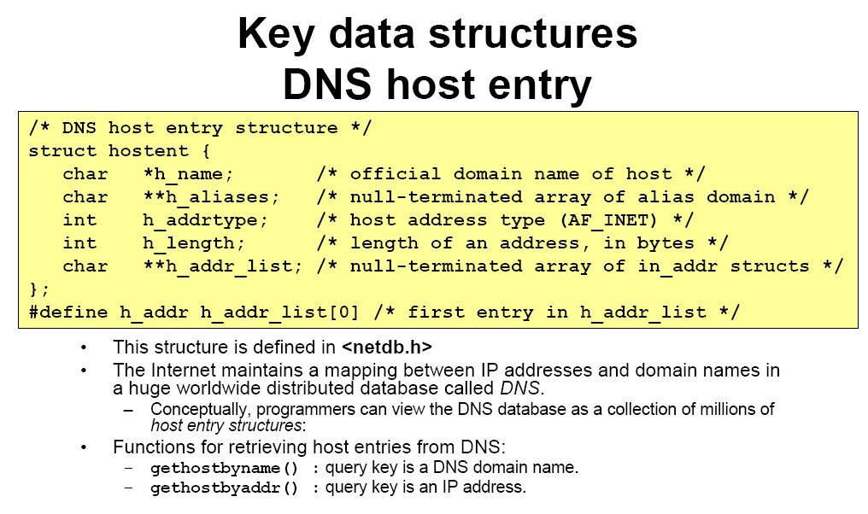

Slide 11
Connection-oriented vs Connectionless Communications
Difference between TCP and UDP
  Connection-oriented
    First, connection is established between two ends
    Then, they communicate through the connection
  Connectionless (datagram)
    Whenever, one sends message to the other; the destination address is included (no connection)
    Packet could be lost or delivered out of order

Slide 12
Socket Programming with Connectionless Protocol
Server
(connectionless protocol)
socket()
bind()
Client
recvfrom()
socket()
Blocks until data received from client
bind()
Data (request)
sendto()
Process request
sendto()
Data (reply)
recvfrom()

Slide 13
Socket Programming with
Connection-Oriented Protocol
Server
(connection-oriented protocol)
socket()
bind()
listen()
Client
accept()
socket()
Blocks until connection from client
Connection establishment
connect()
Data (request)
write()
read()
Process request
write()
Data (reply)
read()

Slide 14
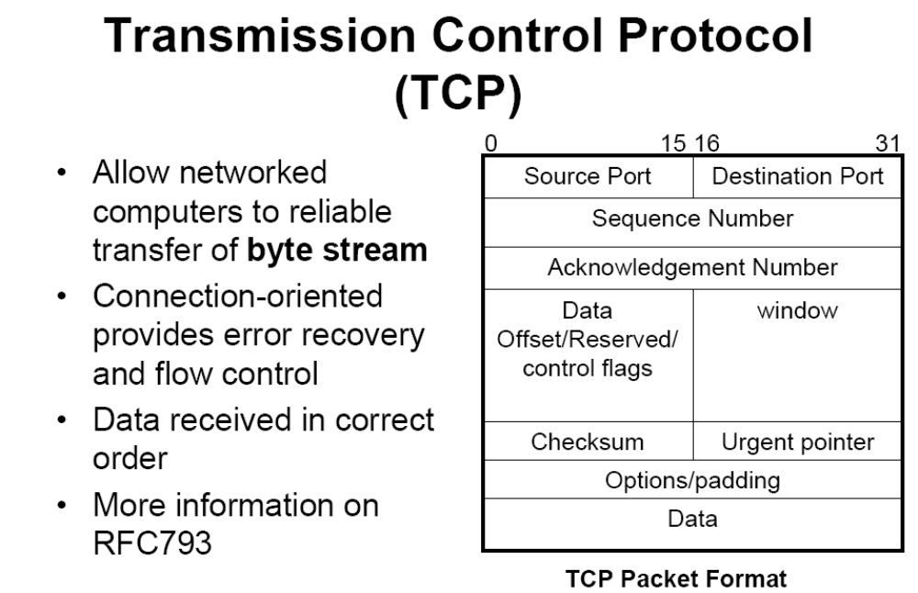

Slide 15
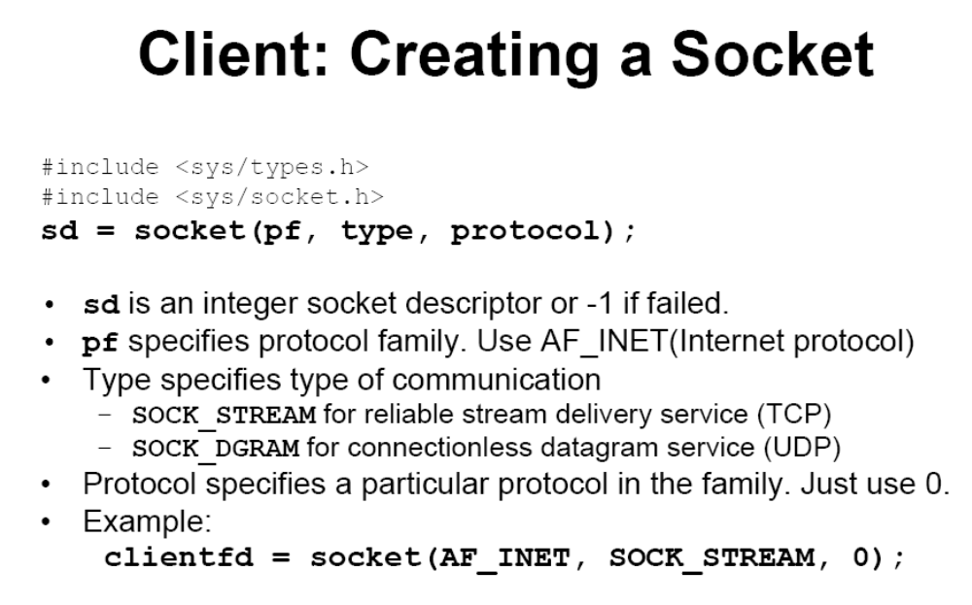

Slide 16
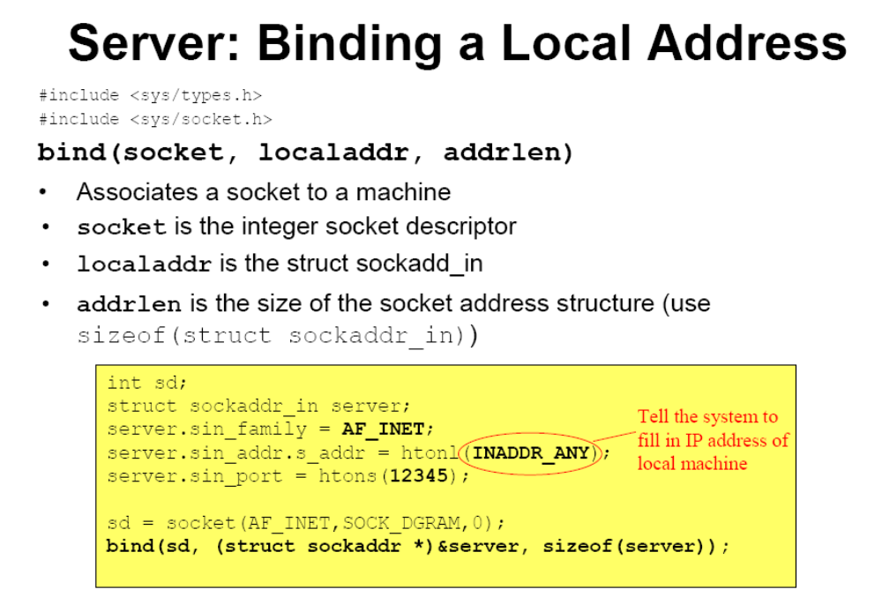

Slide 17
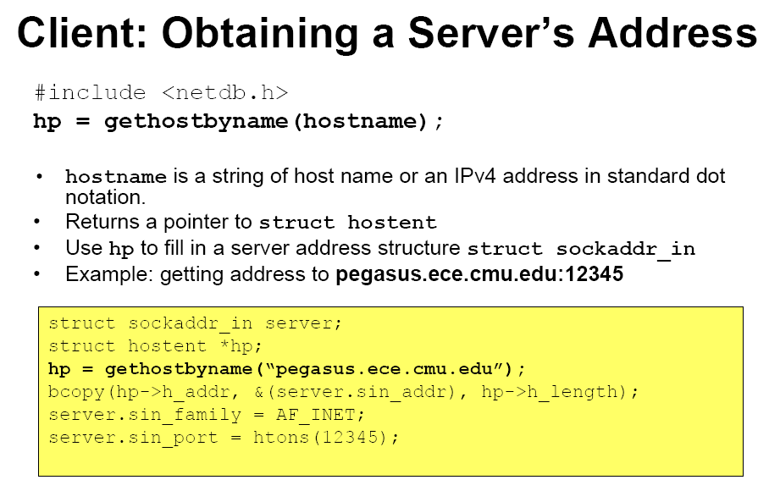

Slide 18
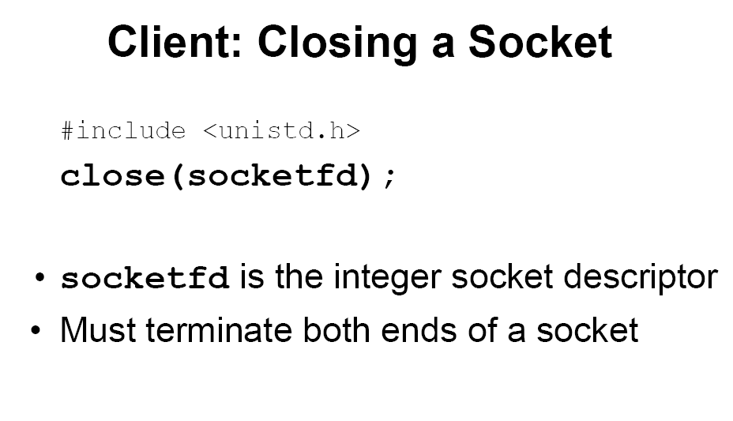

Slide 19
UDP Socket Programming

Slide 20
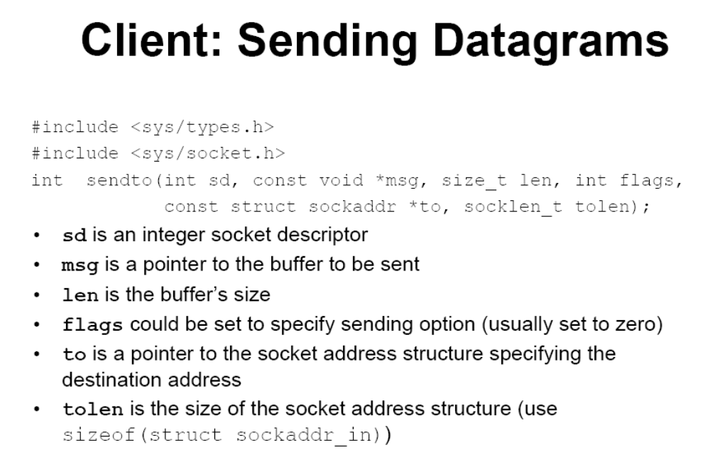

Slide 21
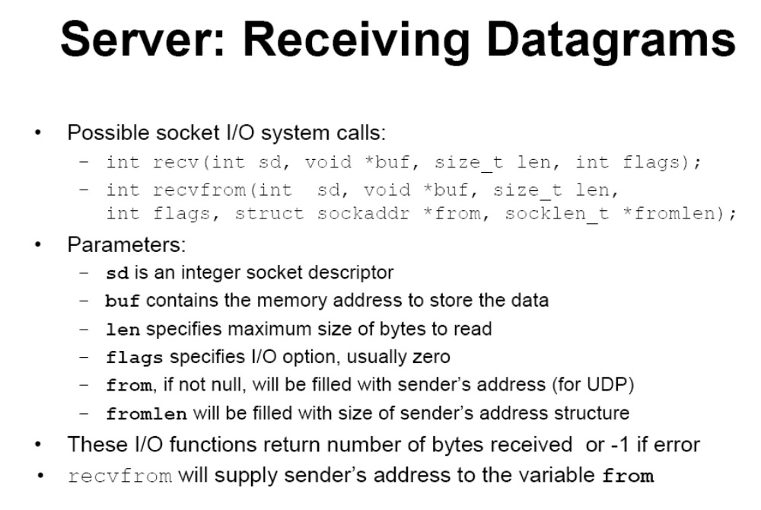

Slide 22
unp.h
/* include unp.h */
#ifndef __unp_h
#define __unp_h
#include <sys/types.h> /* basic system data types */
#include <sys/socket.h> /* basic socket definitions */
#include <netinet/in.h> /* sockaddr_in{} and other Internet defns */
#include <sys/time.h> /* timeval{} for select() */
#include <time.h> /* timespec{} for pselect() */
#include <netdb.h>
#include <signal.h>
#include <stdio.h>
#include <stdlib.h>
#define SERV_PORT 9877 /* TCP and UDP */
#define MAXLINE 4096 /* max text line length */
#define BUFFSIZE 8192 /* buffer size for reads and writes */
#endif /* __unp_h */

Slide 23
UDP Echo Client
#include "unp.h"
int
main(int argc, char **argv)
{
int sockfd;
struct sockaddr_in servaddr;
if (argc != 2)
err_quit("usage: udpcli <IPaddress>");
bzero(&servaddr, sizeof(servaddr));
servaddr.sin_family = AF_INET;
servaddr.sin_port = htons(SERV_PORT);
Inet_pton(AF_INET, argv[1], &servaddr.sin_addr);
sockfd = Socket(AF_INET, SOCK_DGRAM, 0);
dg_cli(stdin, sockfd, (SA *) &servaddr, sizeof(servaddr));
exit(0);
}

Slide 24
DG Client Echo Processing
#include "unp.h"
void
dg_cli(FILE *fp, int sockfd, const SA *pservaddr, socklen_t servlen)
{
int n;
char sendline[MAXLINE], recvline[MAXLINE + 1];
socklen_t len;
struct sockaddr *preply_addr;
preply_addr = Malloc(servlen);
while (Fgets(sendline, MAXLINE, fp) != NULL) {
Sendto(sockfd, sendline, strlen(sendline), 0, pservaddr, servlen);
len = servlen;
n = Recvfrom(sockfd, recvline, MAXLINE, 0, preply_addr, &len);
if (len != servlen || memcmp(pservaddr, preply_addr, len) != 0) {
printf("reply from %s (ignored)\n",
Sock_ntop(preply_addr, len));
continue;
}
recvline[n] = 0; /* null terminate */
Fputs(recvline, stdout);
}
}

Slide 25
UDP Echo Server
#include "unp.h"
int
main(int argc, char **argv)
{
int sockfd;
struct sockaddr_in servaddr, cliaddr;
sockfd = Socket(AF_INET, SOCK_DGRAM, 0);
bzero(&servaddr, sizeof(servaddr));
servaddr.sin_family = AF_INET;
servaddr.sin_addr.s_addr = htonl(INADDR_ANY);
servaddr.sin_port = htons(SERV_PORT);
Bind(sockfd, (SA *) &servaddr, sizeof(servaddr));
dg_echo(sockfd, (SA *) &cliaddr, sizeof(cliaddr));
}

Slide 26
DG Server Echo Processing
#include "unp.h"
static void recvfrom_int(int);
static int count;
void
dg_echo(int sockfd, SA *pcliaddr, socklen_t clilen)
{
int n;
socklen_t len;
char mesg[MAXLINE];
Signal(SIGINT, recvfrom_int);
n = 240 * 1024;
Setsockopt(sockfd, SOL_SOCKET, SO_RCVBUF, &n, sizeof(n));
for ( ; ; ) {
len = clilen;
Recvfrom(sockfd, mesg, MAXLINE, 0, pcliaddr, &len);
count++;
}
}
static void
recvfrom_int(int signo)
{
printf("\nreceived %d datagrams\n", count);
exit(0);
}

Slide 27
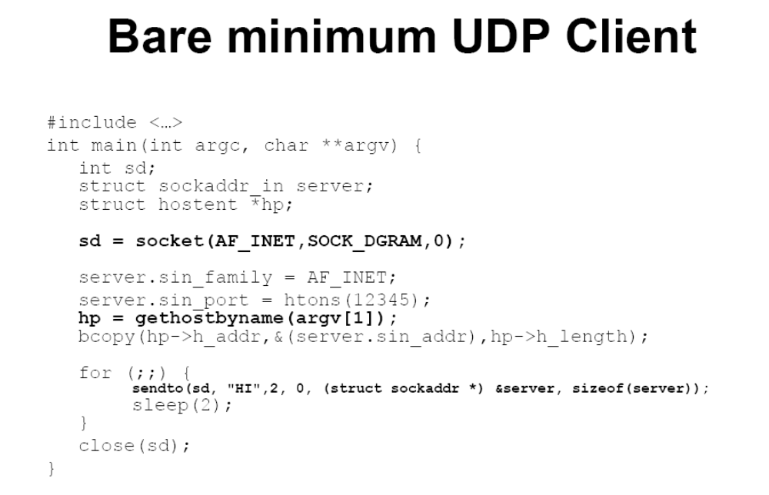

Slide 28
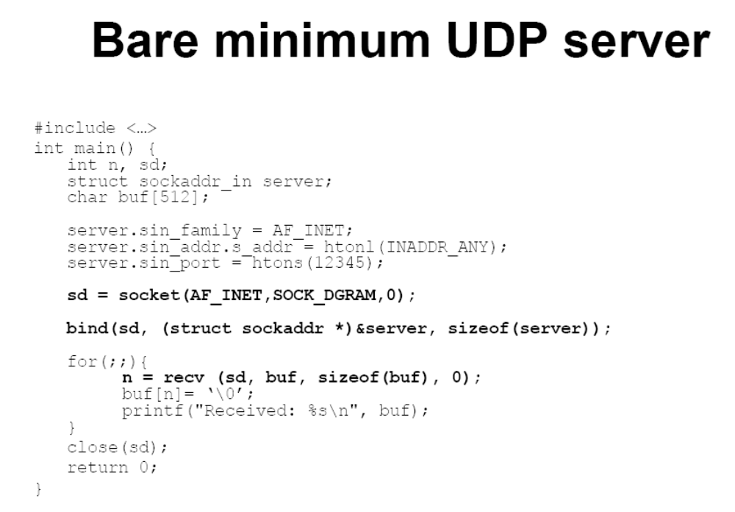

Slide 29
TCP Socket Programming

Slide 30
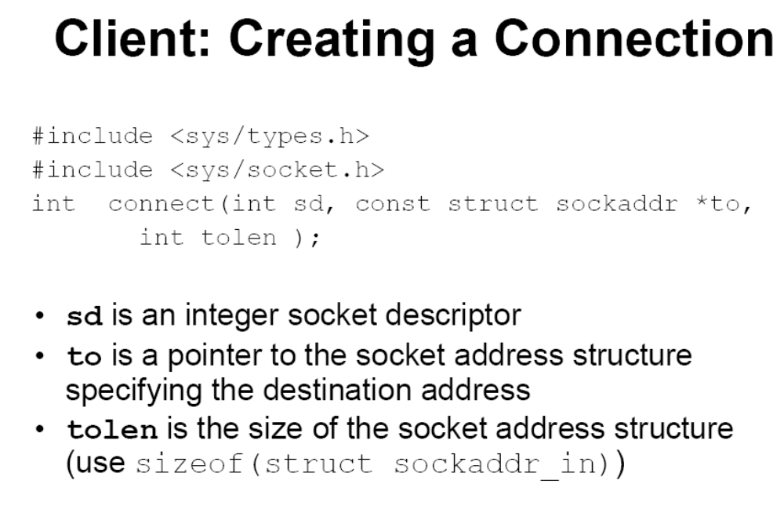

Slide 31
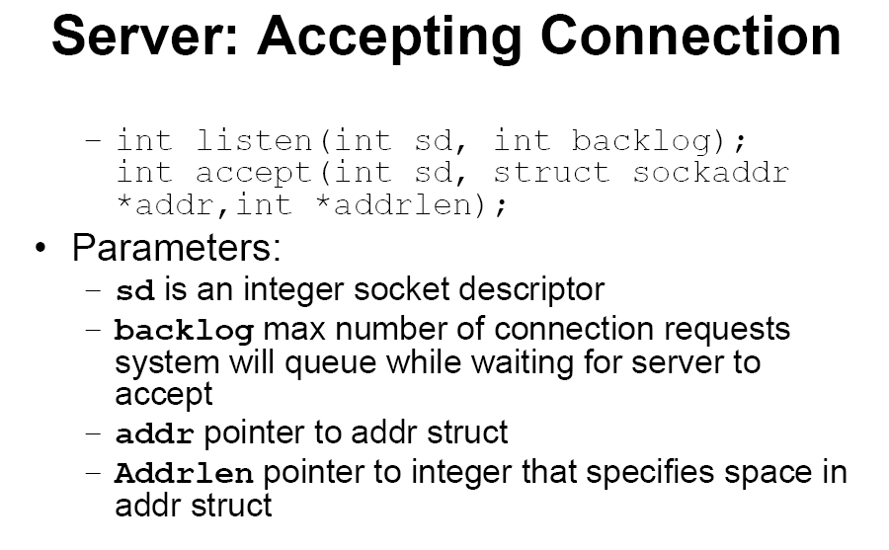

Slide 32
TCP Client
#include "unp.h"
int
main(int argc, char **argv)
{
int sockfd;
struct sockaddr_in servaddr;
if (argc != 2)
err_quit("usage: tcpcli <IPaddress>");
sockfd = Socket(AF_INET, SOCK_STREAM, 0);
bzero(&servaddr, sizeof(servaddr));
servaddr.sin_family = AF_INET;
servaddr.sin_port = htons(SERV_PORT);
Inet_pton(AF_INET, argv[1], &servaddr.sin_addr);
Connect(sockfd, (SA *) &servaddr, sizeof(servaddr));
str_cli(stdin, sockfd); /* do it all */
exit(0);
}

Slide 33
String Client
#include "unp.h"
void
str_cli(FILE *fp, int sockfd)
{
char sendline[MAXLINE], recvline[MAXLINE];
while (Fgets(sendline, MAXLINE, fp) != NULL) {
Writen(sockfd, sendline, strlen(sendline));
if (Readline(sockfd, recvline, MAXLINE) == 0)
err_quit("str_cli: server terminated prematurely");
Fputs(recvline, stdout);
}
}

Slide 34
TCP Server
#include "unp.h"
int
main(int argc, char **argv)
{
int listenfd, connfd;
pid_t childpid;
socklen_t clilen;
struct sockaddr_in cliaddr, servaddr;
listenfd = Socket(AF_INET, SOCK_STREAM, 0);
bzero(&servaddr, sizeof(servaddr));
servaddr.sin_family = AF_INET;
servaddr.sin_addr.s_addr = htonl(INADDR_ANY);
servaddr.sin_port = htons(SERV_PORT);
Bind(listenfd, (SA *) &servaddr, sizeof(servaddr));
Listen(listenfd, LISTENQ);
for ( ; ; ) {
clilen = sizeof(cliaddr);
connfd = Accept(listenfd, (SA *) &cliaddr, &clilen);
if ( (childpid = Fork()) == 0) { /* child process */
Close(listenfd); /* close listening socket */
str_echo(connfd); /* process the request */
exit(0);
}
Close(connfd); /* parent closes connected socket */
}
}

Slide 35
String Server Echo Processing
#include "unp.h"
void
str_echo(int sockfd)
{
long arg1, arg2;
ssize_t n;
char line[MAXLINE];
for ( ; ; ) {
if ( (n = Readline(sockfd, line, MAXLINE)) == 0)
return; /* connection closed by other end */
if (sscanf(line, "%ld%ld", &arg1, &arg2) == 2)
snprintf(line, sizeof(line), "%ld\n", arg1 + arg2);
else
snprintf(line, sizeof(line), "input error\n");
n = strlen(line);
Writen(sockfd, line, n);
}
}

Slide 36
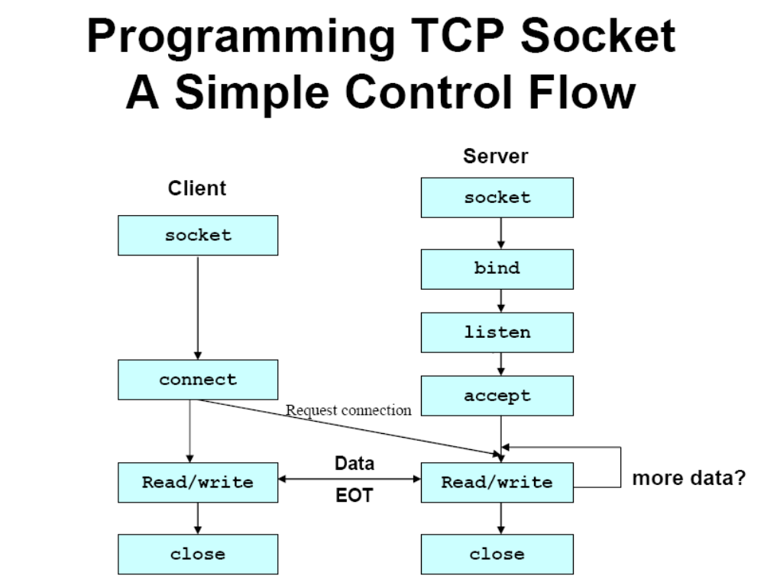

Slide 37
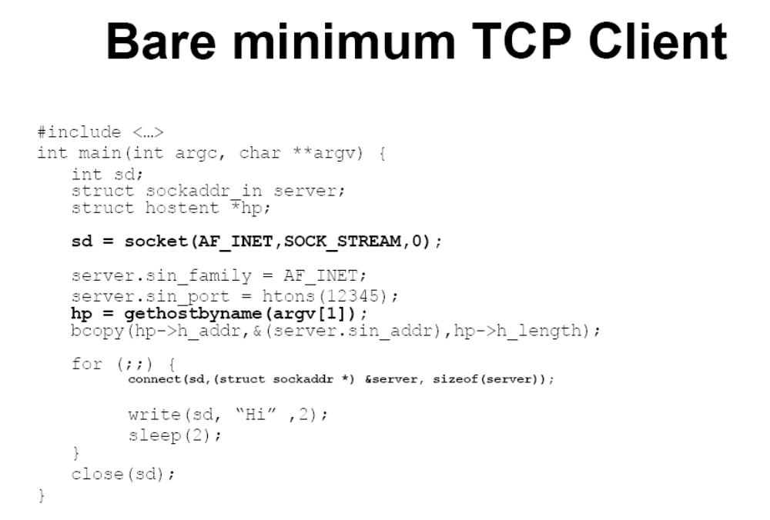

Slide 38
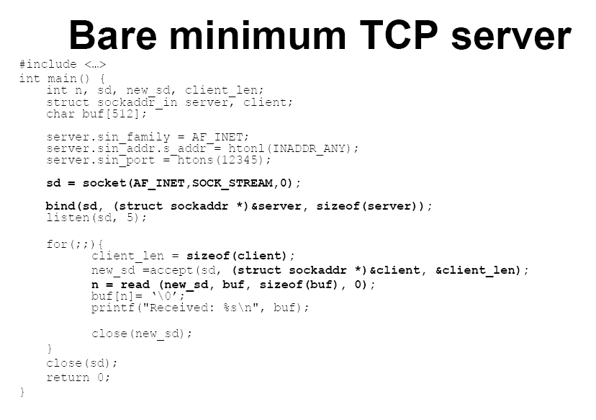

Slide 39
Reference
http://www.linuxhowtos.org/C_C++/socket.htm
Use tux175 – tux198 in Davis 123

